Slide 1
Directory Management
17BIT026
17BIT034

Slide 2
Introduction
The project demonstrates directory management using PERL. In directory management we can perform basic CRUD operations on directories. CRUD stands for Creating, Retrieving, Updating and Deleting directories.

Slide 3
CRUD - Creating
We use PERL to create directories in a directory.

Slide 4
CRUD - Retrieving
We use PERL to retrieve the list of all the directories present inside the specified directory.

Slide 5
CRUD - Updating
Updating or renaming the specified directory using PERL.

Slide 6
CRUD - Deleting
Deleting a directory with the specified name using PERL.

Slide 7
GUI - Graphical User Interface
We used the Tk library in PERL to create the desired GUI for our application.

Slide 8
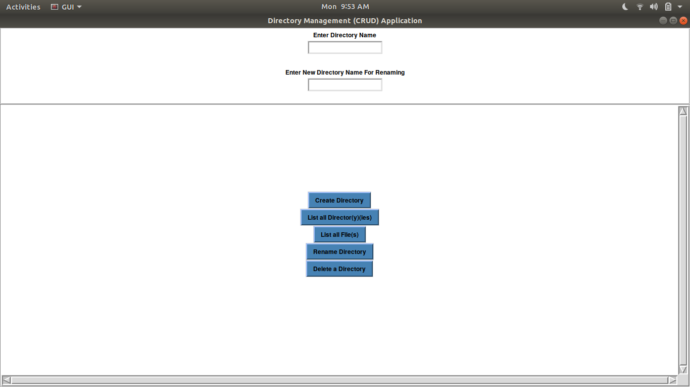
Basic Layout

Slide 9
Thank you

